Slide 1

Graphical passwords to avoiding shoulder surfing
Batch No:CSI-12
Guided By
Rajesh Sir
Rupak Sir
Project members
Shanmuk Pandranki(Lead)
K.V.S.P Akhilesh
Jahnavi

Slide 2
Slide Map
ABSTRACT
TERMINOLOGY USED
EXISTING SYSTEM
BLOCK DIAGRAM
PROPOSED SYSTEM
SYSTEM ARCHITECTURE
PROJECT DESCRIPTION
SYSTEM REQUIREMENTS
ADVANTAGES
IMPLEMENTATION
RESULTS
CONCLUSION
REFERENCES
www.techionary.info

Slide 3
Abstract
Almost everyone of us faced an issue like we have been watched when we type our credentials. This is called Shoulder Surfing. Though it looks normal, it leads to serious issues like password theft and leads to hacked user accounts.So, it prevent these type of Shoulder surfing attacks taking place we have to implement a new type of authenticating system like using graphical passwords instead of convetional passwords.
In this project, we have made two ways of implementing graphical passwords.Using these two ways we can easily prevent someone from Shoulder Surfing.
In future, there is a plan for dynamically taking every picture using in the project from the internet so that the shoulder surfer could not even guess what the pattern used in the authentication process.
www.techionary.info

Slide 4
Terminology Used
Python3.8
Hypertext Markup Language(HTML)
Cascading Stylesheets(CSS)
Javascript(Js)
Bootstrap
Flask
SQLAlchemy
Flask_login
Werkzeug. Security(Sha-256)
www.techionary.info

Slide 5
Existing System
In the login page the user enters his username or mail-id
Then they enter password using keyboard which contains alphanumeric characters and special symbols(least care about these symbols)
Then they click Login
The server validates the username and password with the existing data from the database.
If the validation is successful then they will be directed forward to their accounts.
If it fails they will be warned that “Username and password is wrong”.
www.techionary.info

Slide 6
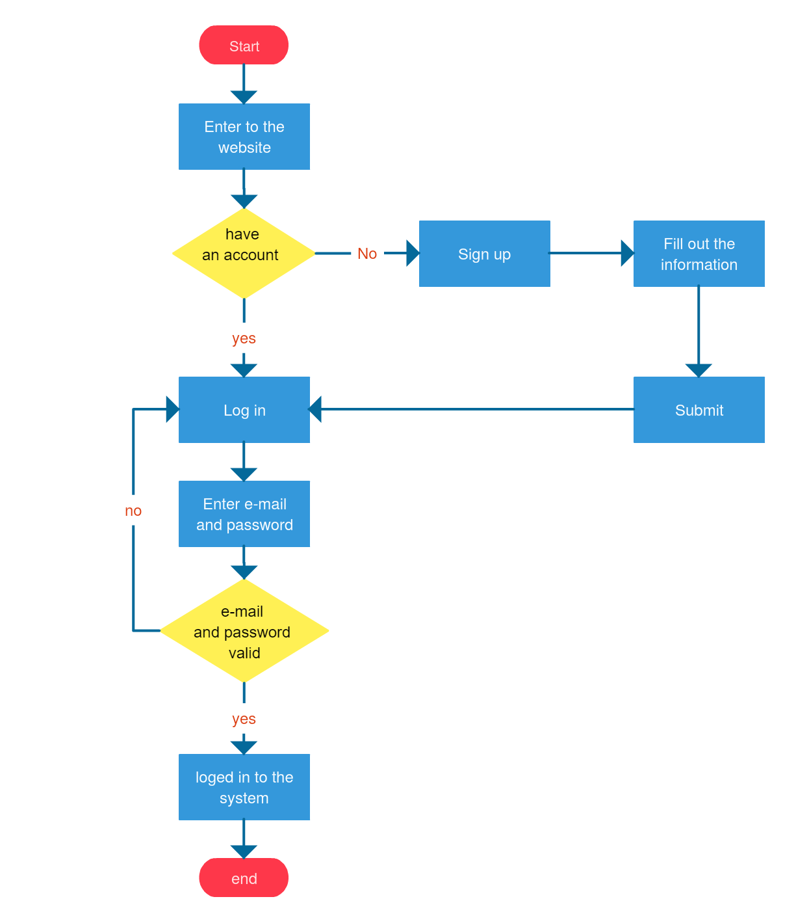
Block Diagram
www.techionary.info

Slide 7
Proposed System
Method-1
In this method, a user have to signup first using his mail-id username.
Then he will be shown a table of pictures where he has to select a minimum of 4.
Now he has to signup for his account.
During his login, he has to enter his mail-id or username.
Again he will be shown the same set of images as of signup page and he has to select the same images which he previously selected to signup his account.
The images changes their positions randomly and he has a privilege to select images in any order but should select all the images.
If the selected images matches with the images in the database,he will be allowed to login.
Method-2
In this method, during the signup the user first has to enter his mail-id and username.
Then he will be shown 2sets of images and he has to select one from each.
Now he is allowed to signup for his account.
During his login, he has to enter his mail-id or username.
Then he will be shown a table of images.
Here, the first row and first column images appears to be the same images as in the signup page.
Remaining images are gathered from the internet dynamically.
In order to login,the user has should remember his selected images one from first row and one from first column .
Now he has to select an image which lies corresponding to those images inside the table.
If he selects the correct position, he will be logged in else he will not.
www.techionary.info

Slide 8
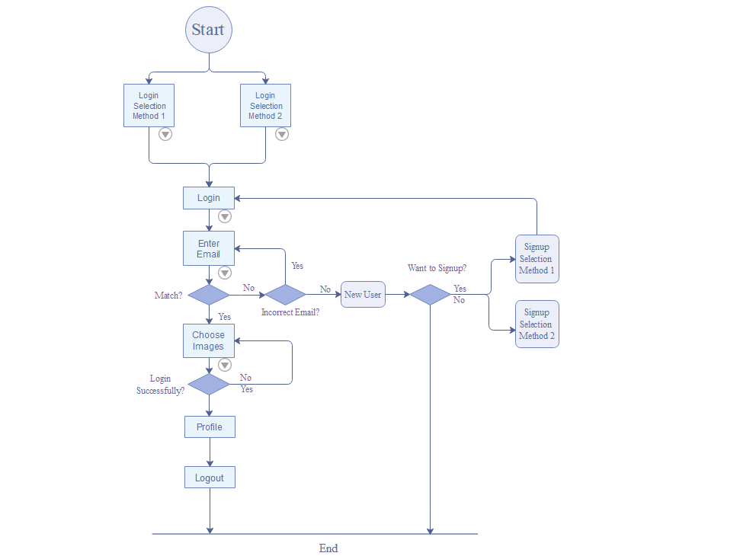
System Architecture
www.techionary.info

Slide 9
Project Description
There are more risk of shoulder surfing in the conventional method of authenticating.
Shoulder surfing is a serious issue which leads to stealing of user credentials which leads to serious issues.
So, there is a major need to change our style of authenticating to reduce these type of attacks.
Using graphical passwords we can reduce shoulder surfing attacks to some extent.
Though some type of graphical passwords are easy to remember it the style of implementation that makes it difficult for shoulder surfing.
www.techionary.info

Slide 10
System Requirements
Python3.x to be installed.
The following modules are to be installed:
Flask
SQLAlchemy
Flask_login
Werkzeug.Security
www.techionary.info

Slide 11
Advantages
It is user-friendly.
It provides higher security than other traditional password schemes.
Dictionary attacks are infeasible.
www.techionary.info

Slide 12
Implementation
Method-1
In this method, a user have to signup first using his mail-id username.
Then he will be shown a table of pictures where he has to select a minimum of 4.
Now he has to signup for his account.
During his login, he has to enter his mail-id or username.
Again he will be shown the same set of images as of signup page and he has to select the same images which he previously selected to signup his account.
The images changes their positions randomly and he has a privilege to select images in any order but should select all the images.
If the selected images matches with the images in the database,he will be allowed to login.
Method-2
In this method, during the signup the user first has to enter his mail-id and username.
Then he will be shown 2sets of images and he has to select one from each.
Now he is allowed to signup for his account.
During his login, he has to enter his mail-id or username.
Then he will be shown a table of images.
Here, the first row and first column images appears to be the same images as in the signup page.
Remaining images are gathered from the internet dynamically.
In order to login,the user has should remember his selected images one from first row and one from first column .
Now he has to select an image which lies corresponding to those images inside the table.
If he selects the correct position, he will be logged in else he will not.
www.techionary.info

Slide 13
Results
Our project aim is to reduce shoulder surfing. So, we figured out these to ways which reduces shoulder surfing to a greater extent.
www.techionary.info

Slide 14
Conclusion
In a graphical password authentication system, the user has to select from images, in a specific order, presented to them in a graphical user interface (GUI).Using this graphical password authentication we can prevent shoulder surfing to a maximum extent.
www.techionary.info

Slide 15
References
https://www.geeksforgeeks.org/graphical-password-authentication/
https://stackoverflow.com/questions/17541614/use-images-instead-of-radio-buttons
https://flask.palletsprojects.com/en/1.1.x/patterns/flashing/
www.techionary.info

